Slide 1
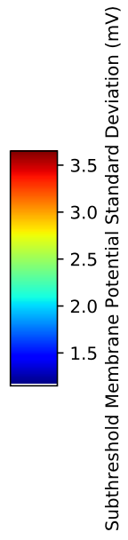
SDprox1
SDprox2
Number of Common Inhibitory Inputs
Number of Common Excitatory Inputs

